Slide 1

Charlotte County Economic Development
Welcome to the 🌪️ 2025 Hurricane Preparedness Webinar for Businesses

Slide 2
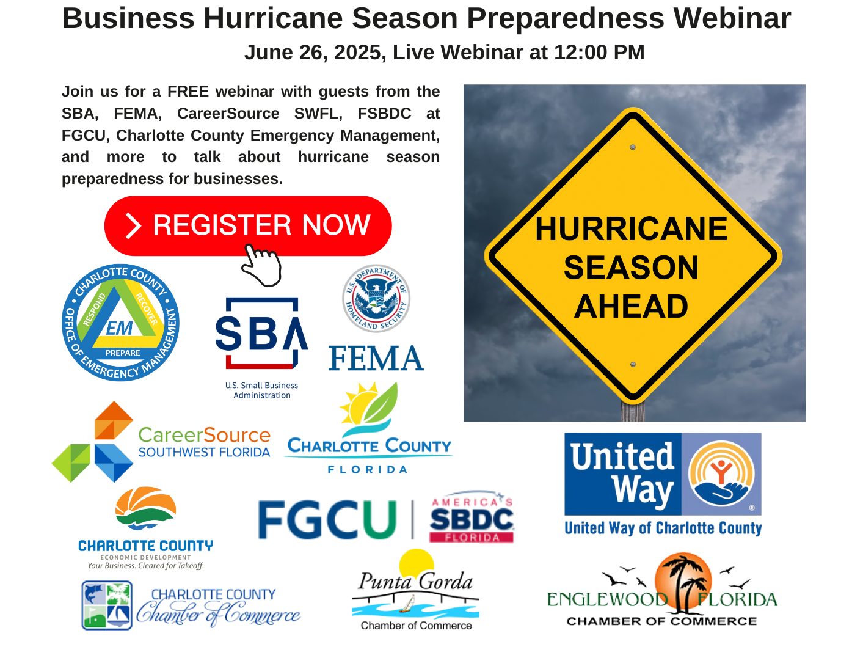
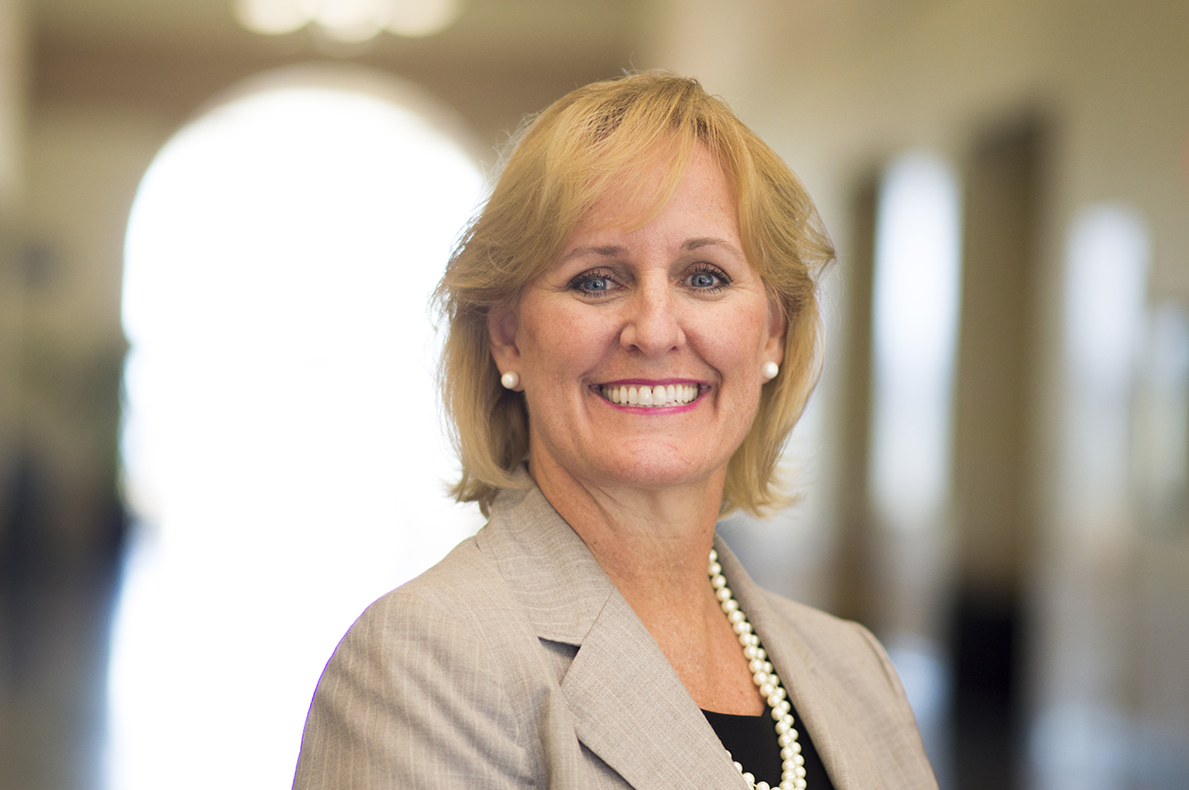
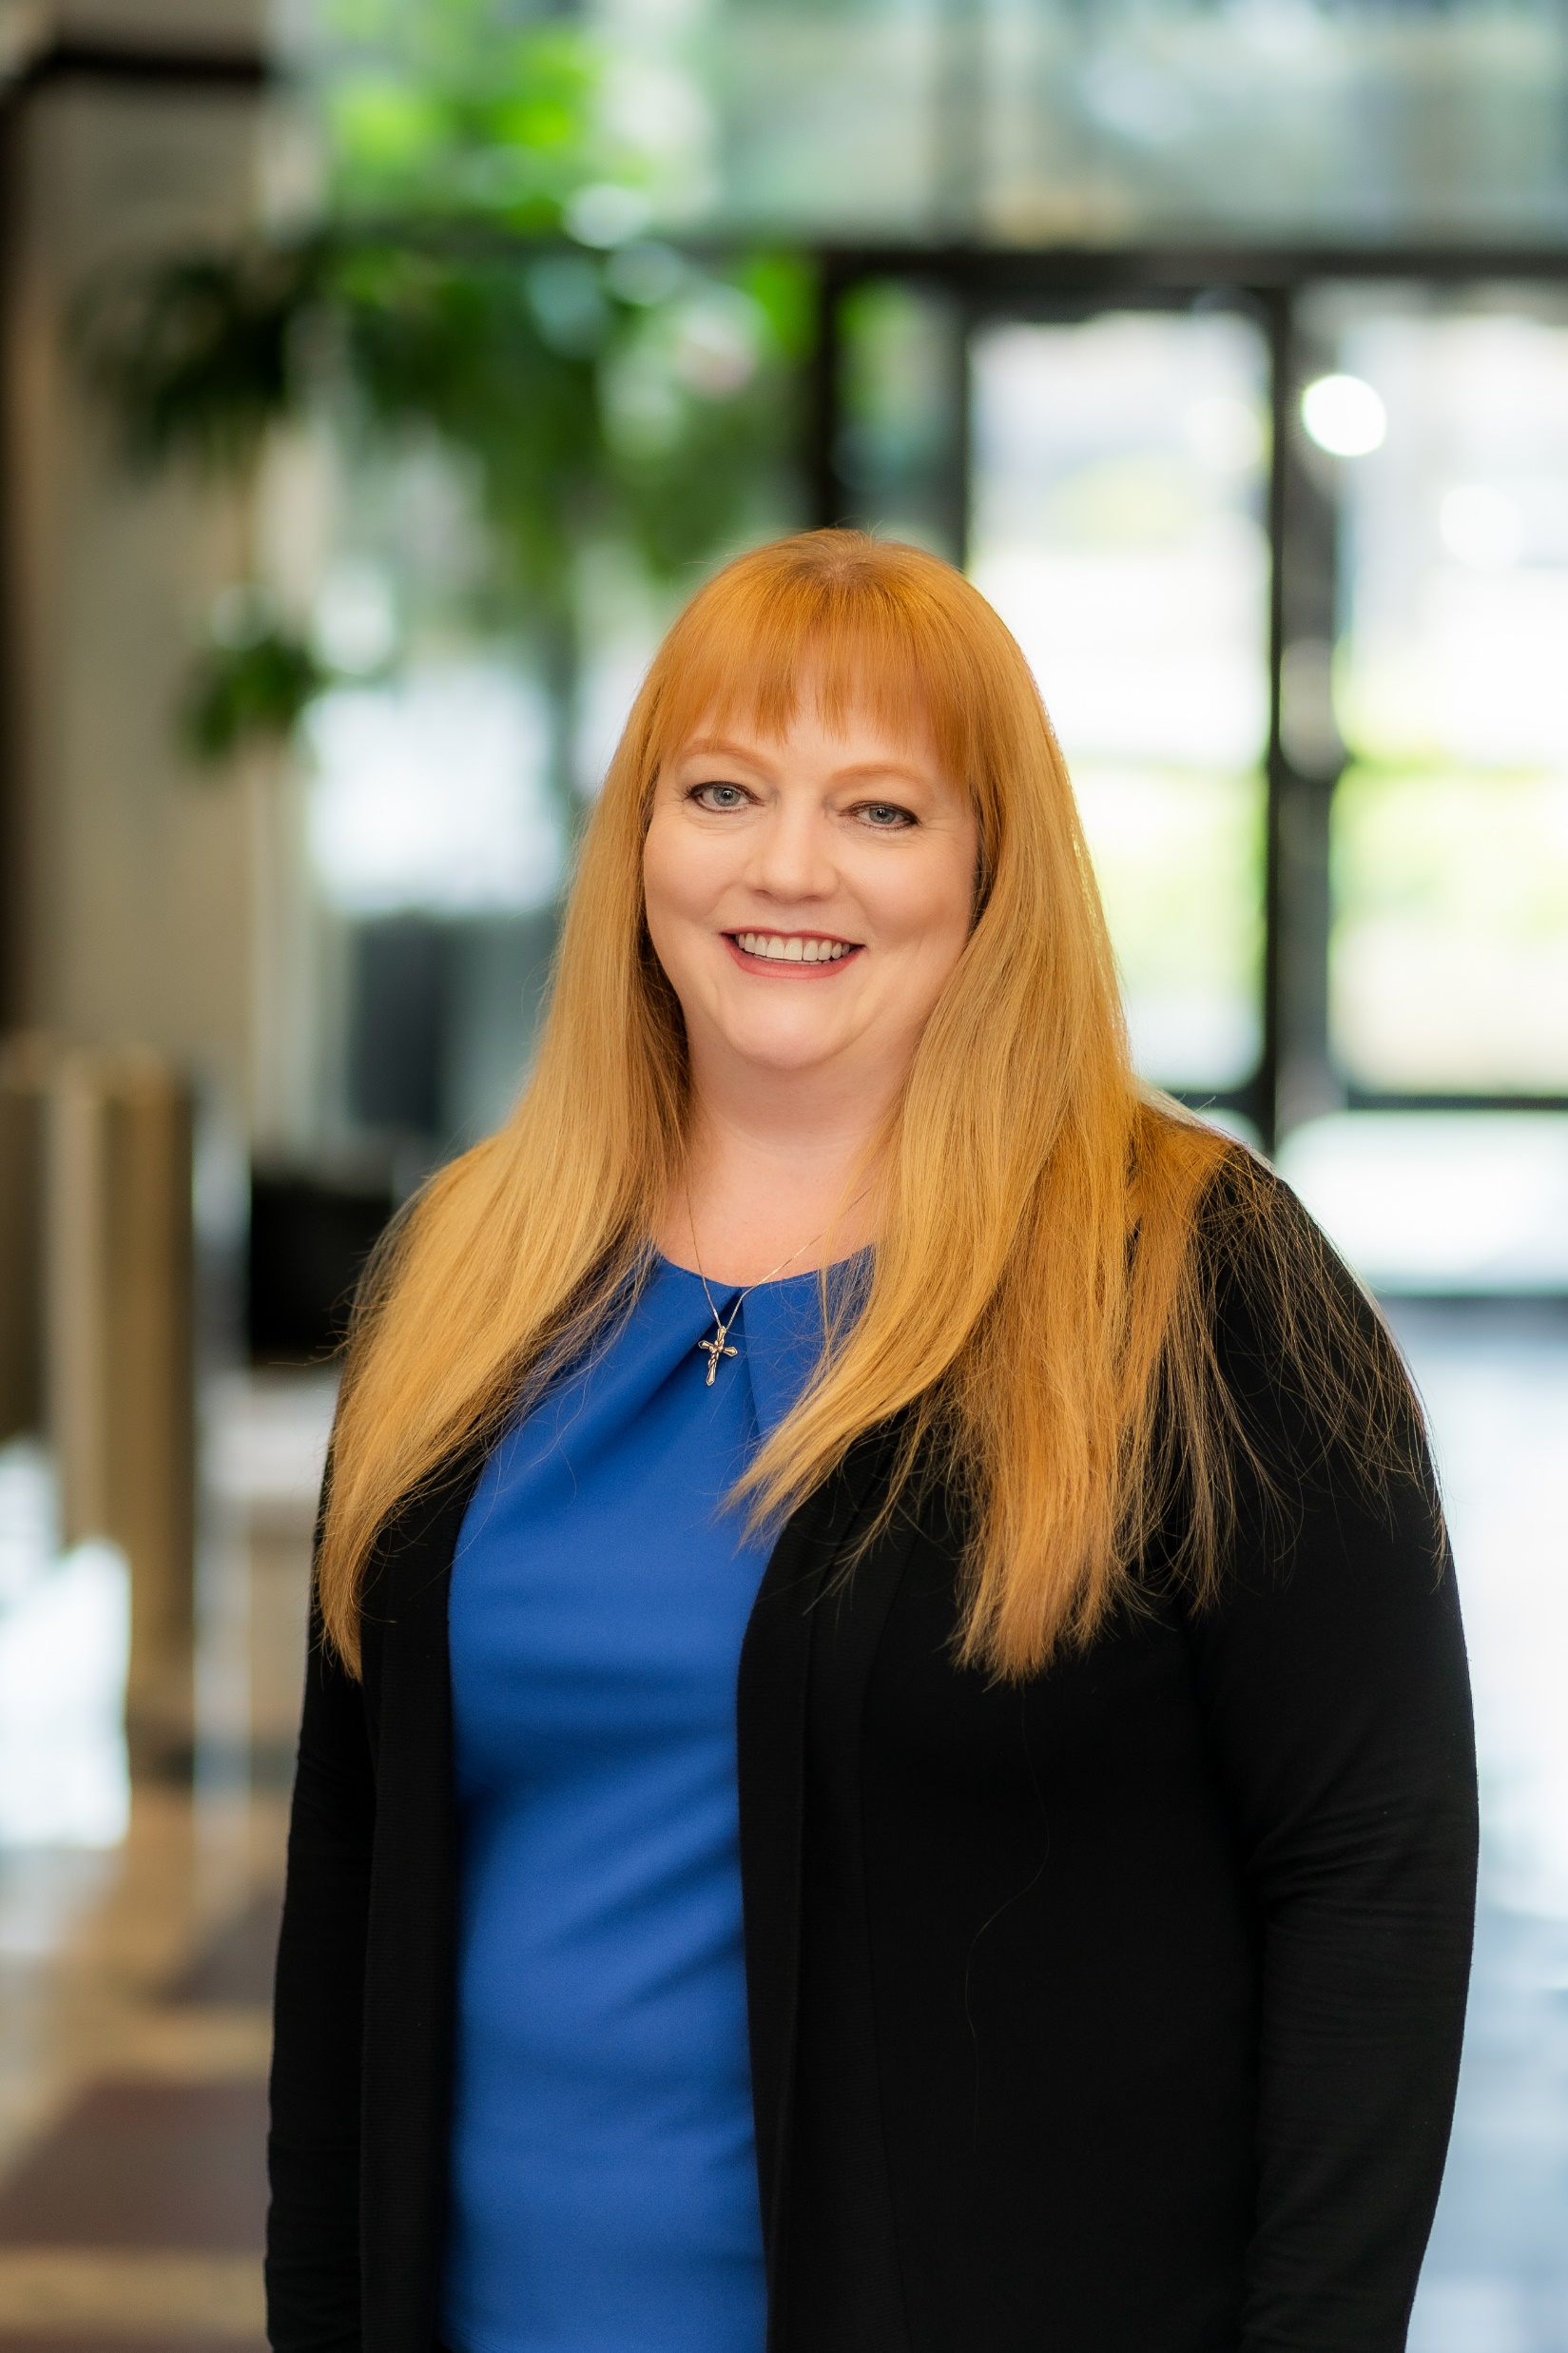
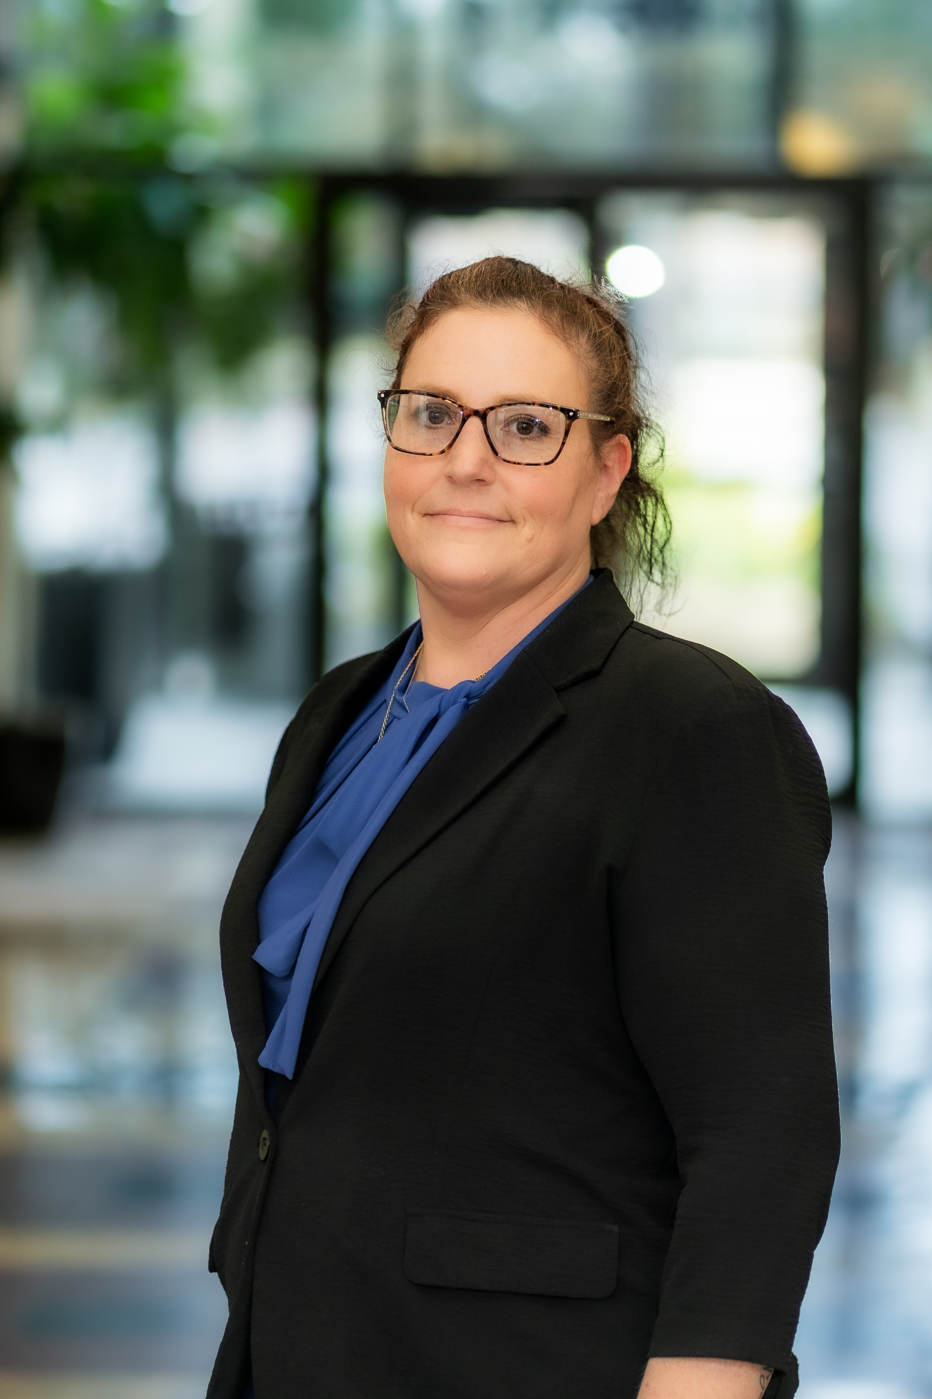
Kay Tracy
Kristy Sisler
Director of Economic Development
Maria Vastola
Marketing Manager
Business Recruitment Manager

Slide 3



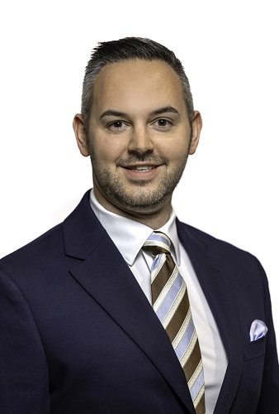
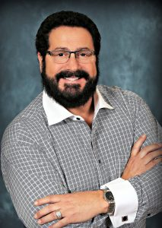
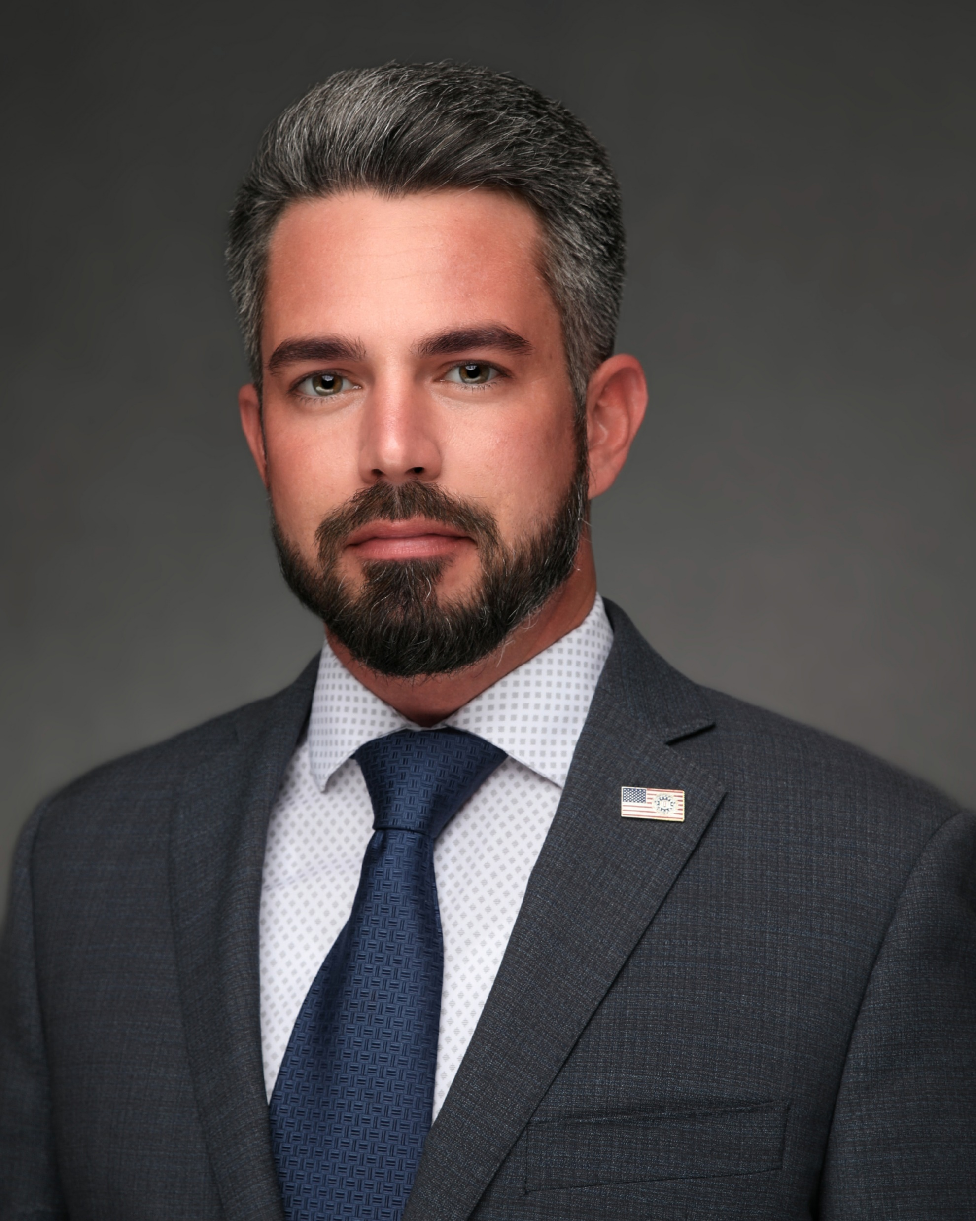
Bob White
Executive Director Charlotte County Chamber of Commerce
Doug Izzo
Executive Director Englewood Chamber of Commerce
Justin Brand
Executive Director
Punta Gorda Chamber of Commerce

Slide 4
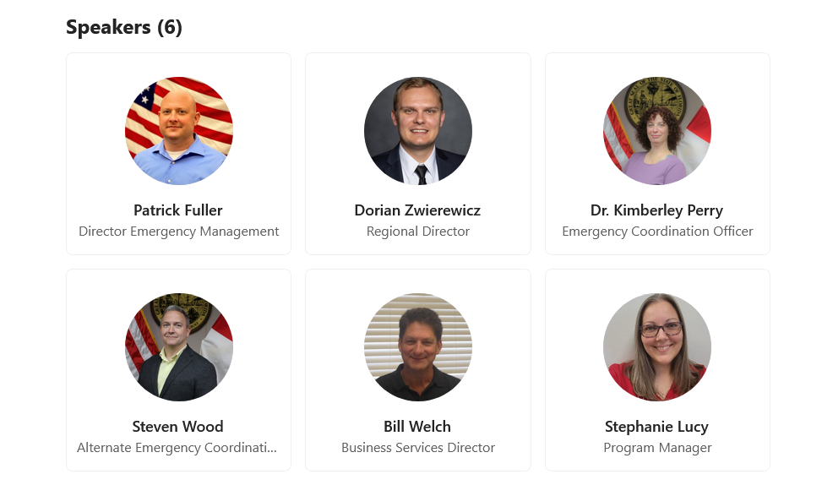

Slide 5
Hurricane Preparedness
June 26, 2025

Slide 6
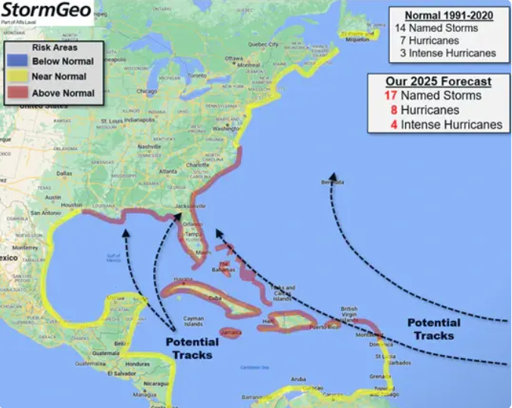
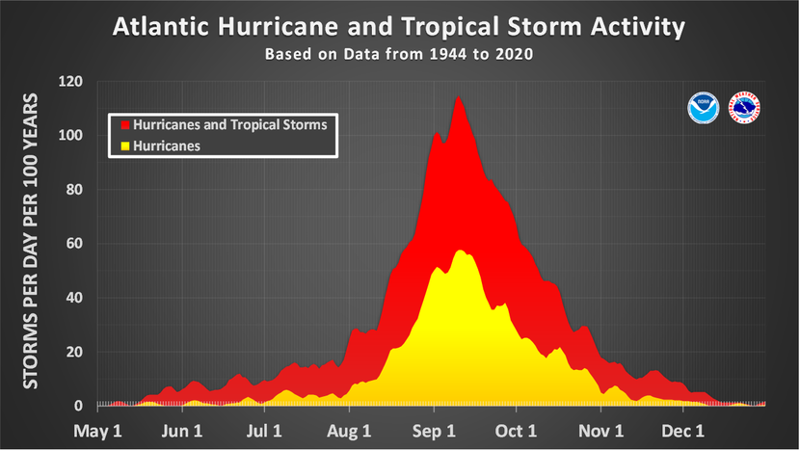
Season Ahead
 | Seasonal Average | AccuWeather | Colorado State University | StormGeo
Named Storms | 14.4 | 13-18 | 17 | 17
Hurricanes | 7.2 | 7-10 | 9 | 8
Major Hurricanes | 3.2 | 3-5 | 4 | 4

Slide 7
10 Year Review
2015 | 2016 | 2017 | 2018 | 2019 | 2020 | 2021 | 2022 | 2023 | 2024
12 | 15 | 17 | 15 | 18 | 30 | 21 | 14 | 20 | 18
11 | 7 | 10 | 8 | 6 | 14 | 7 | 8 | 7 | 11
4 | 4 | 6 | 2 | 3 | 7 | 4 | 2 | 3 | 5
 |  |  |  |  | 1st | 3rd |  | 4th
Named Storms
Hurricanes
Major Hurricane
All Time

Slide 8
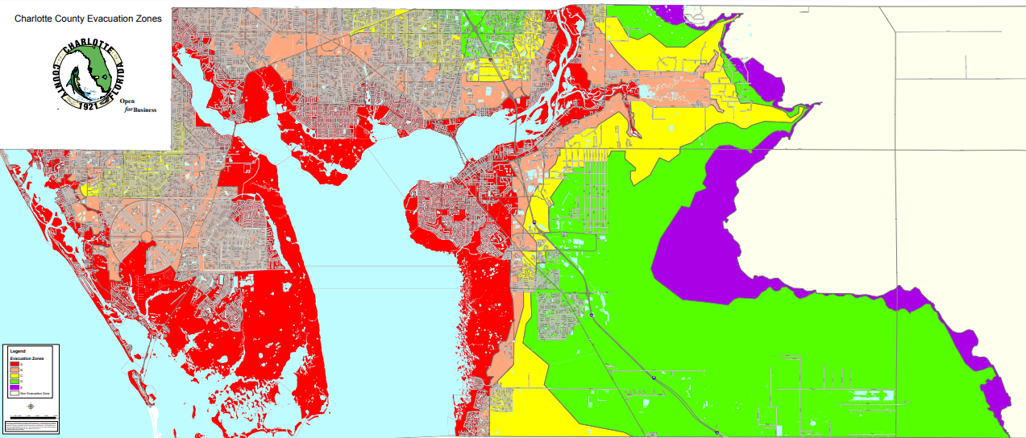
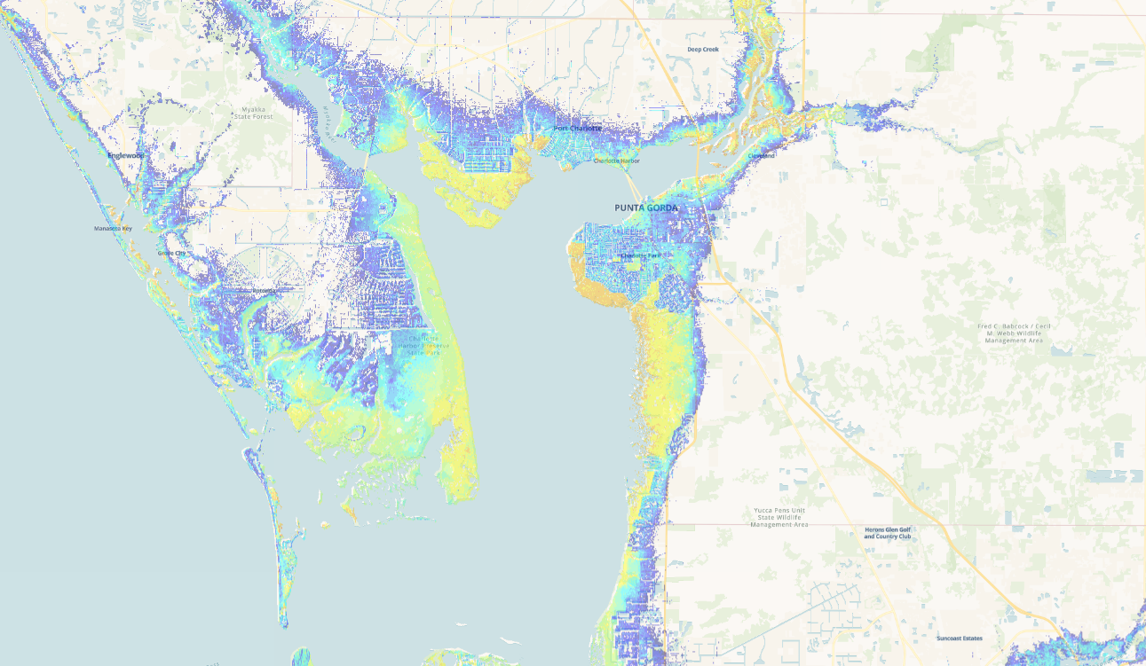
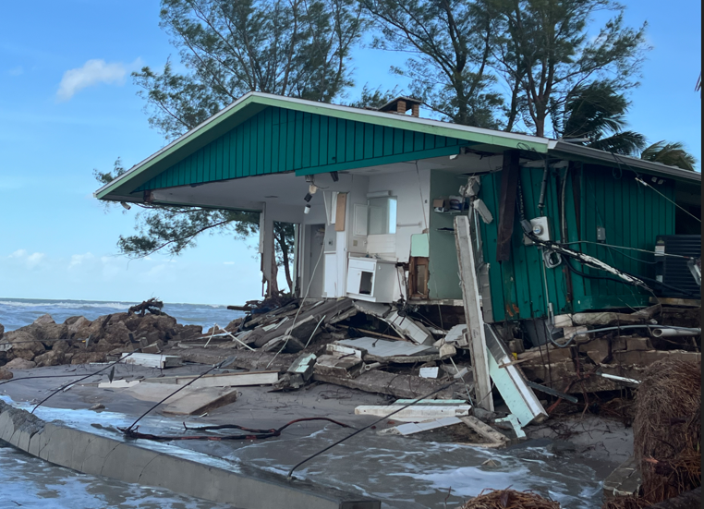
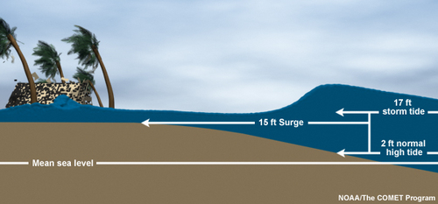
Storm Surge
Definition: an abnormal water level rise generated by a storm over and above the predicted astronomical tide.
Evacuation Zones – Extreme Vulnerability
Can travel miles inland
Influenced by direction of storm, depth of water, forward speed, intensity, size of storm

Slide 9
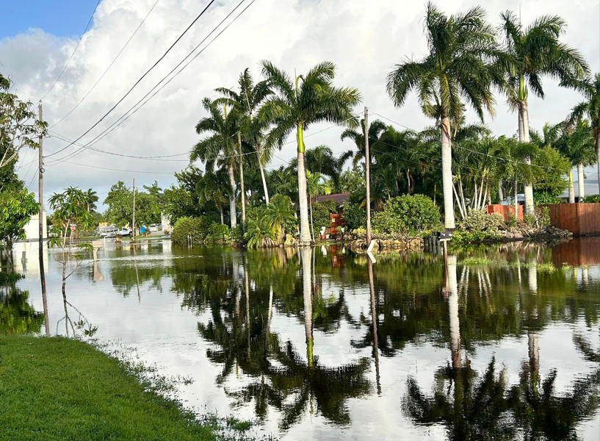
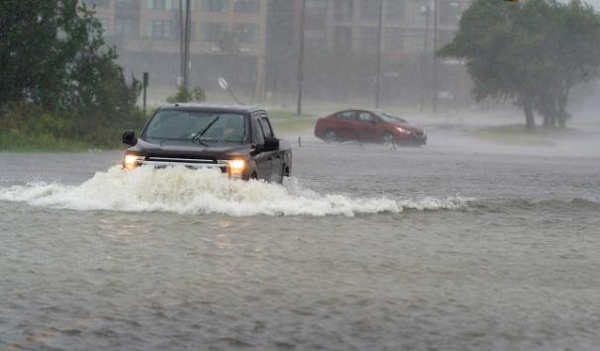
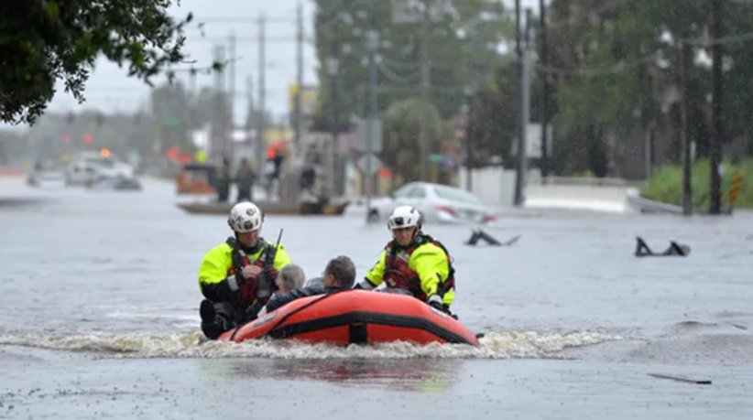
Flooding Rainfall
Intense and or prolonged rainfall
Ponding, depressions, surfaces, soil saturation…Flood Zone
“Turn Around, Don’t Drown”

Slide 10
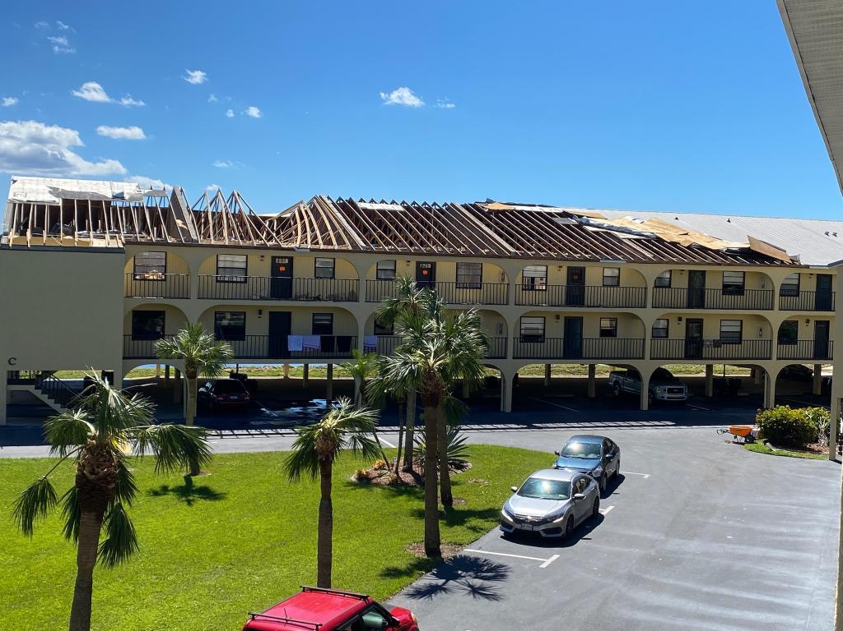
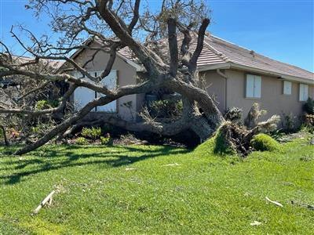
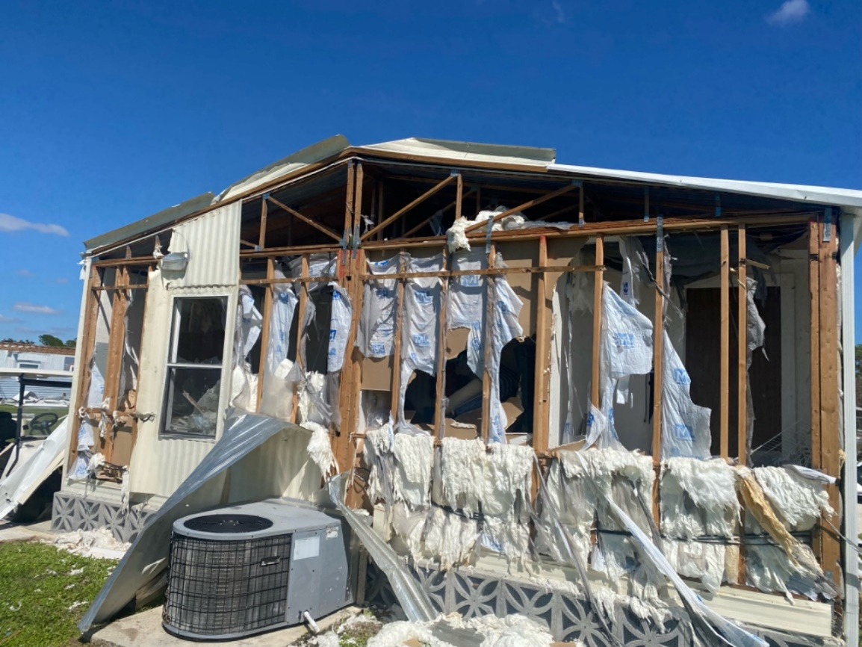
Damaging Wind
Hurricane Category
Tornado potential
Building code

Slide 11
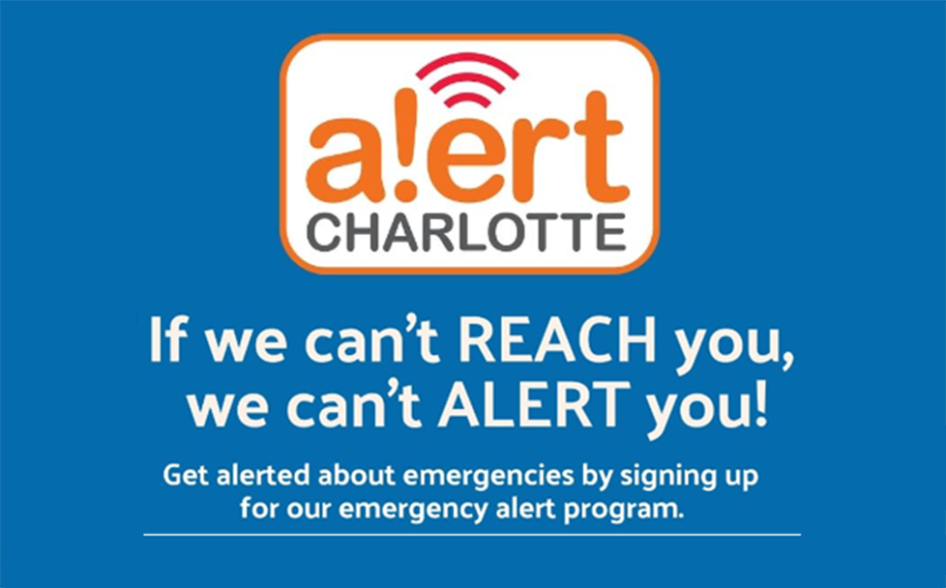
Culture of Preparedness
Household Preparedness
Understand Your Risk
Make a Plan
Prepare (Disaster Kits, Documents)
Stay Informed
Business Preparedness
Employee Preparedness
Continuity Planning
Look after your employees

Slide 12
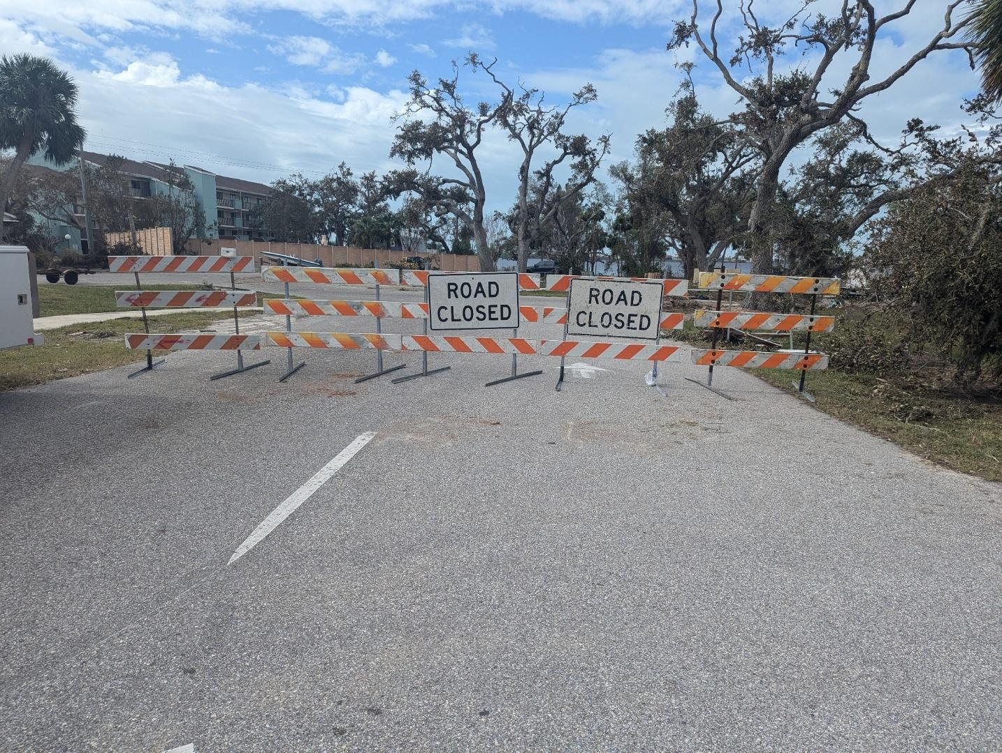
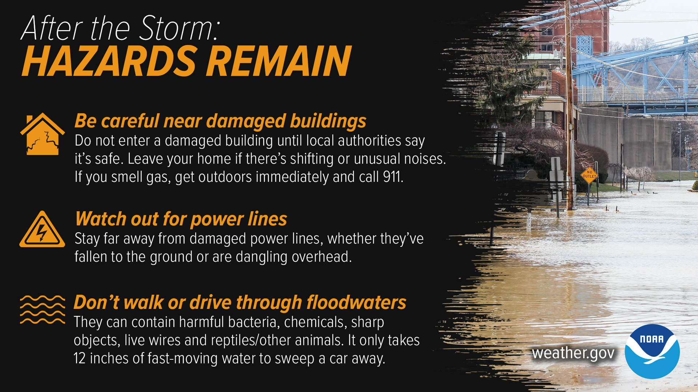
Before, During and After
Secure your home
Evacuate when directed to do so…
Minimize travel (5 to 7 days of supplies)
SAFETY
Check on neighbors
Stay Informed

Slide 13
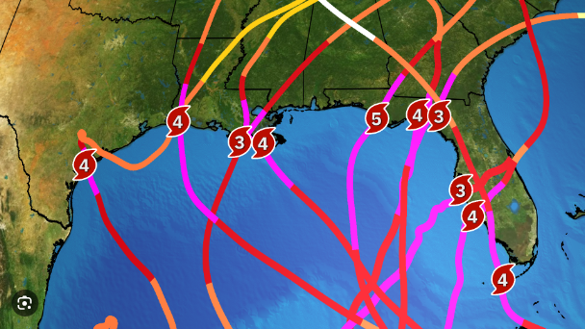
Why do we Prepare?
?
Irma
Eta
Isaias
Ian
Idalia
Red Tide
2017
2018
2019
2020
2021
2022
2023
2024
2025
Feb. Tornadoes
Dorian
Elsa
Jan. Tornadoes
Debby
Helene
Milton
I--------------COVID-19--------------I
A Culture of Preparedness leads to a Resilient community

Slide 14
Charlotte County Emergency Management
Questions?
941-833-4000 Emergency.Management@CharlotteCountyFL.gov

Slide 15
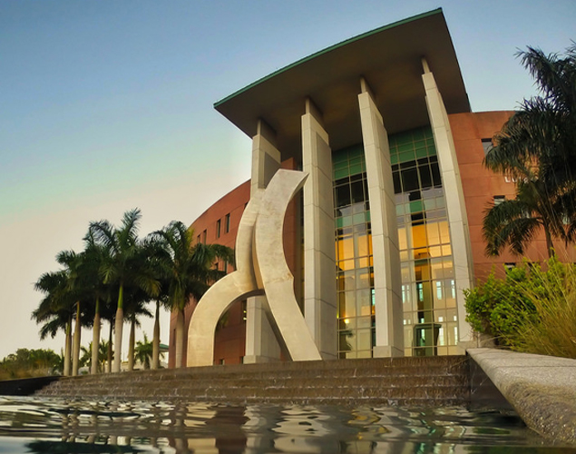

Small
Business
Development
Center
Dorian Zwierewicz
Regional Director

Slide 16
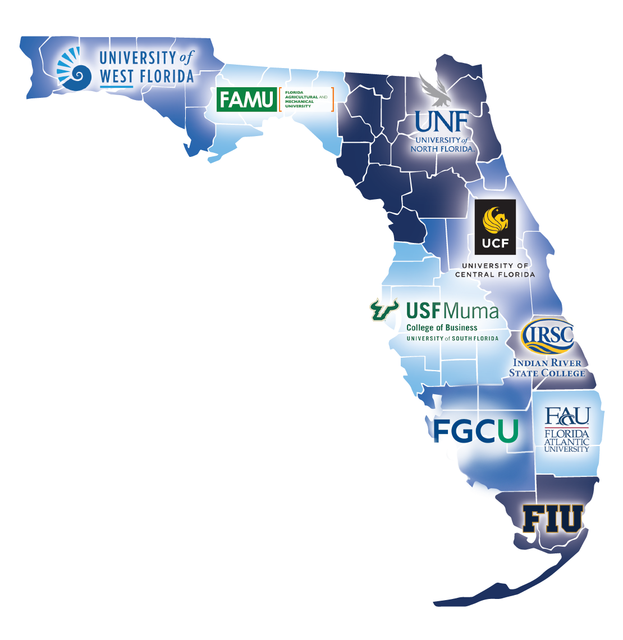
Who We Are
Federally funded
Provide no-cost confidential technical assistance to businesses
"Florida's Principal Provider of Business Assistance"
[ § 288.001, Fla. Stat.]
Partnership of 9 regions

Slide 17
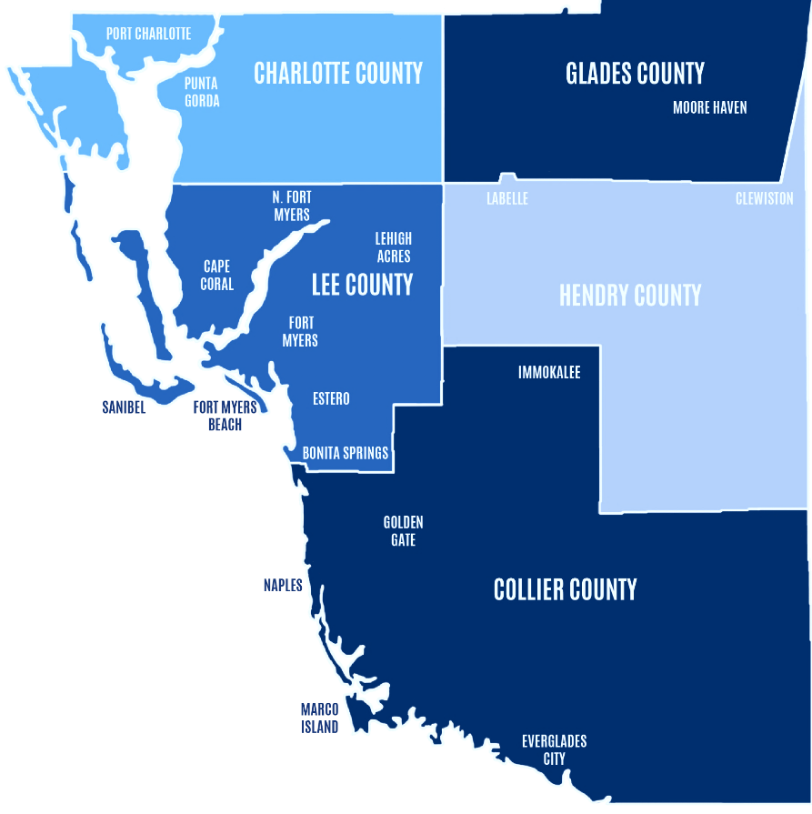
Our Region
Serve 5 counties in SWFL
15 business consultants
4 main offices
Punta Gorda
Cape Coral
Downtown Fort Myers
FGCU (Lutgert College of Business)

Slide 18
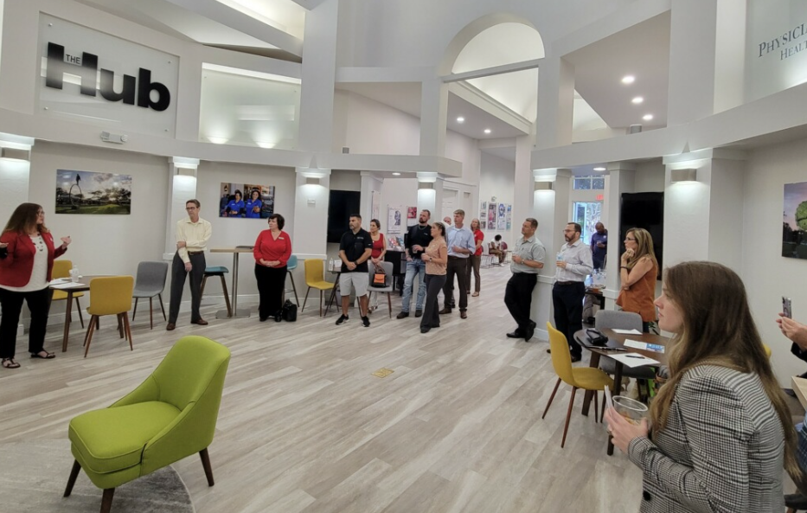
What We Do
Consulting
Training
Outreach
The small business outreach arm of the university

Slide 19
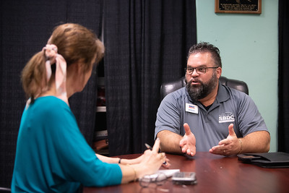
Consulting
Marketing
Capital Access
International Trade
Business Valuations
Government Contracts
Start ups

Slide 20
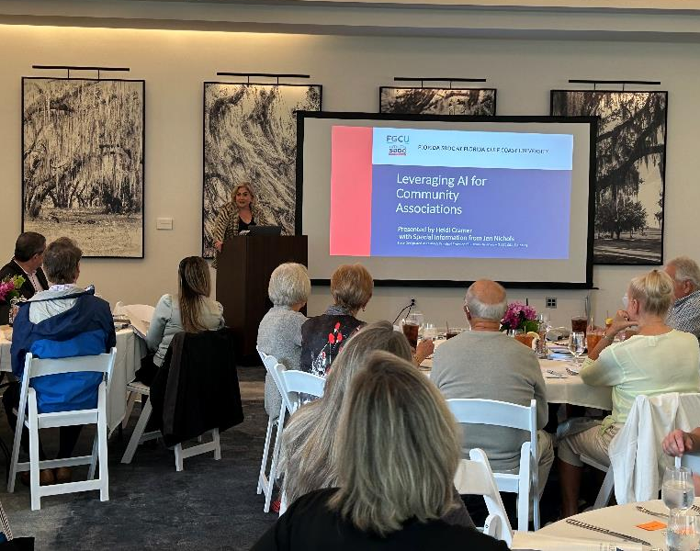
Training
30-50 workshops per year
Topics
Develop your Business Pitch
Myths about Working Capital
Starting a Business
Instagram for Business
Strategic Planning
Government Contracting 101

Slide 21
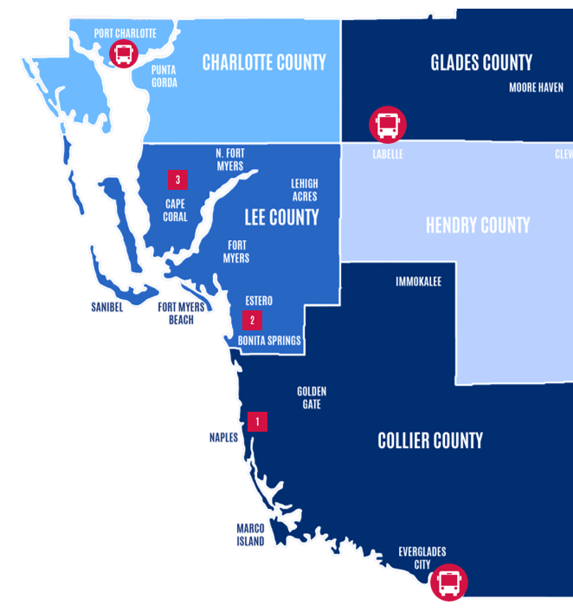
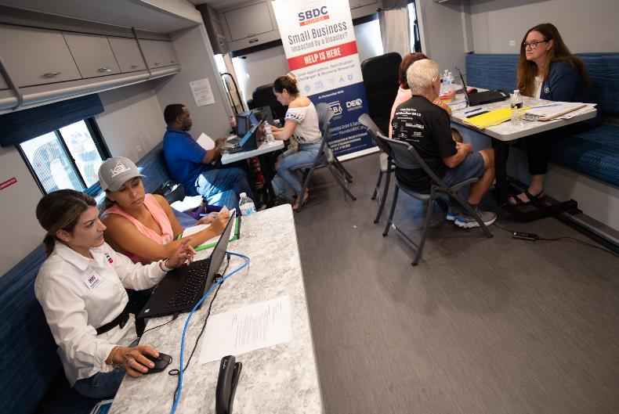
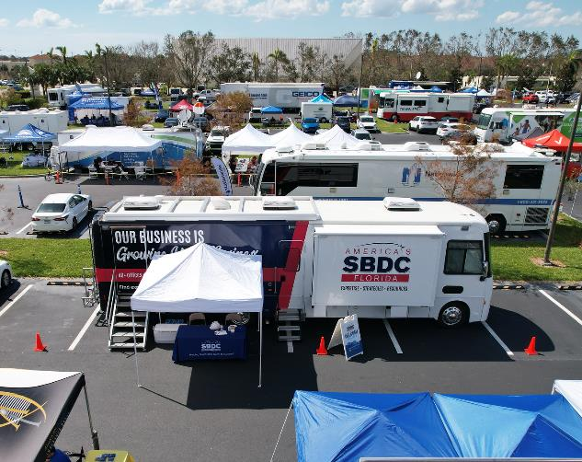
Disaster Recovery

Slide 22
Ready.gov

Slide 23
Ready.gov/business
Business toolkits
Business plans
Training and exercises
Other resources

Slide 24
Loan Programs

Slide 25

Florida Small Business Emergency Bridge Loan
Loan Information
State of Florida Loan
Short-term, zero-interest working capital loans
Gets you funds quickly while you wait for long-term funding
Eligibility requirements
Your business must be located in Florida
Your business must have been established prior to Month Day, 20XX
Your business must be located in an eligible county.
Your business must have been economically injured or physically damaged.
Your business must employ two to 100 employees.
Credit Score of 600 or above
Must be an eligible business
You must have repaid all outstanding previous Emergency Bridge Loans.
Notes:
“This loan is essentially the State of Florida saying, ‘Hello Mr./Mrs. Business Owner. We know you need help and we know you’ll apply for SBA funds or file an insurance claim. We also know that these can take some time. We’ll give you money now for up to one year interest-free. Pay us back once you get that long-term funding and we’ll be good.’”

Slide 26
Emergency Bridge Loan (EBL)
Amount | Up to $50,000 per eligible business
Terms | Up to one year (do not forget this)
Interest | 0 percent; after one year the loan goes into default and the interest jumps to 12 percent
Payments | Must be repaid in full by the maturity date
Other | Only for small businesses with 2-100 employees Meant to “bridge the gap” until a business gets other long-term financing
How to Apply | https://floridacommerce.my.site.com/RebuildFloridaBusinessLoanFund/s/
Notes:
Amount. The maximum loan amount per eligible business is $50,000.
Terms. The loan is a one year loan. Remember, here at the SBDC we have to act in your best interest. If the loan is not paid off after one year, it goes into default, which can SEVERELY damage your credit. On top of this, the interest rate jumps to XX%.
Only apply for this loan if you’re getting other long-term funding, such as an SBA loan.
Payments. The loan has to be paid off with one year. The State does not care whether you make monthly payments, sporadic payments throughout the year, or wait until the day the loan is due to pay it off in full. As long as you pay off the entire amount within one year, the State is happy.
Other
This loan is for businesses with 2-100. [SBDC Consultant to Research] For this disaster, if you have 1099 independent contractors, they [can/cannot] qualify as an employee for the purposes of the loan.
How to Apply
You can apply by visiting the website on the screen OR visiting your local SBDC representative at a BRC location.

Slide 27
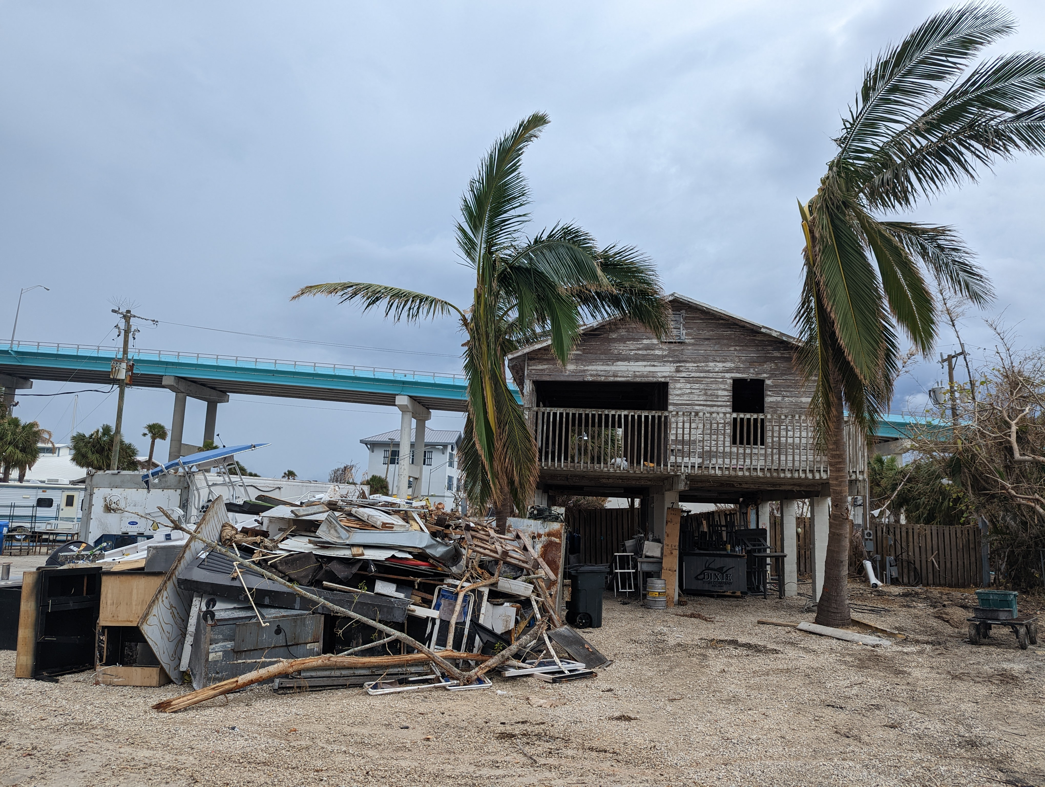
SBA Physical Disaster Loan
Loans to businesses to repair or replace disaster-damaged property owned by the business, including real estate, inventories, supplies, machinery and equipment. Businesses of any size are eligible.
Private, non-profit organizations such as charities, churches, private universities, etc., are also eligible.

Slide 28
SBA Physical Disaster Loan
Eligible Uses
Real property
Machinery
Equipment
Fixtures
Inventory
Leasehold Improvements

Slide 29
SBA Physical Disaster Loan
Collateral
Required for physical loss loans over $25,000.
SBA will not decline a loan for lack of collateral, but requires you to pledge what is available.

Slide 30
SBA Physical Disaster Loan
Amount | Up to $2,000,000 per eligible business
Terms | Up to 30 years; case by case
Interest | Businesses & Small Agricultural Cooperatives 3.75% Non-Profits Organizations 2.75%
Payments | First year deferred payments and no interest accrual Afterwards, it’s a long-term fixed payment
Other | Collateral is required for physical loans over $25,000. SBA will not decline a loan for lack of collateral, but it requires you to pledge what is available.
How to Apply | sba.gov/disaster
Notes:
Amount. The maximum loan amount per eligible business is $2,000,000.
Terms
This is the SBA’s standard disaster recovery loan. As you can see, it’s a long-term low with a really competitive interest rate.
Once you get this long-term long, you pay off the short-term emergency bridge loan and use the remaining funds for long-term recovery.
Payments
The SBA defers payments for the first year.
The SBA also does not accrue interest on disaster loans for the first year.
Other
Although collateral is required for loans over $25,000 the SBA will not decline a loan for lack of collateral. It’s the government giving you a good faith gesture by helping you. If you don’t have enough collateral, they require you to return the same good faith gesture by pledging what you do have.
How to Apply
You can either apply at a Disaster Recovery Center, Business Recovery Center, or go online.

Slide 31
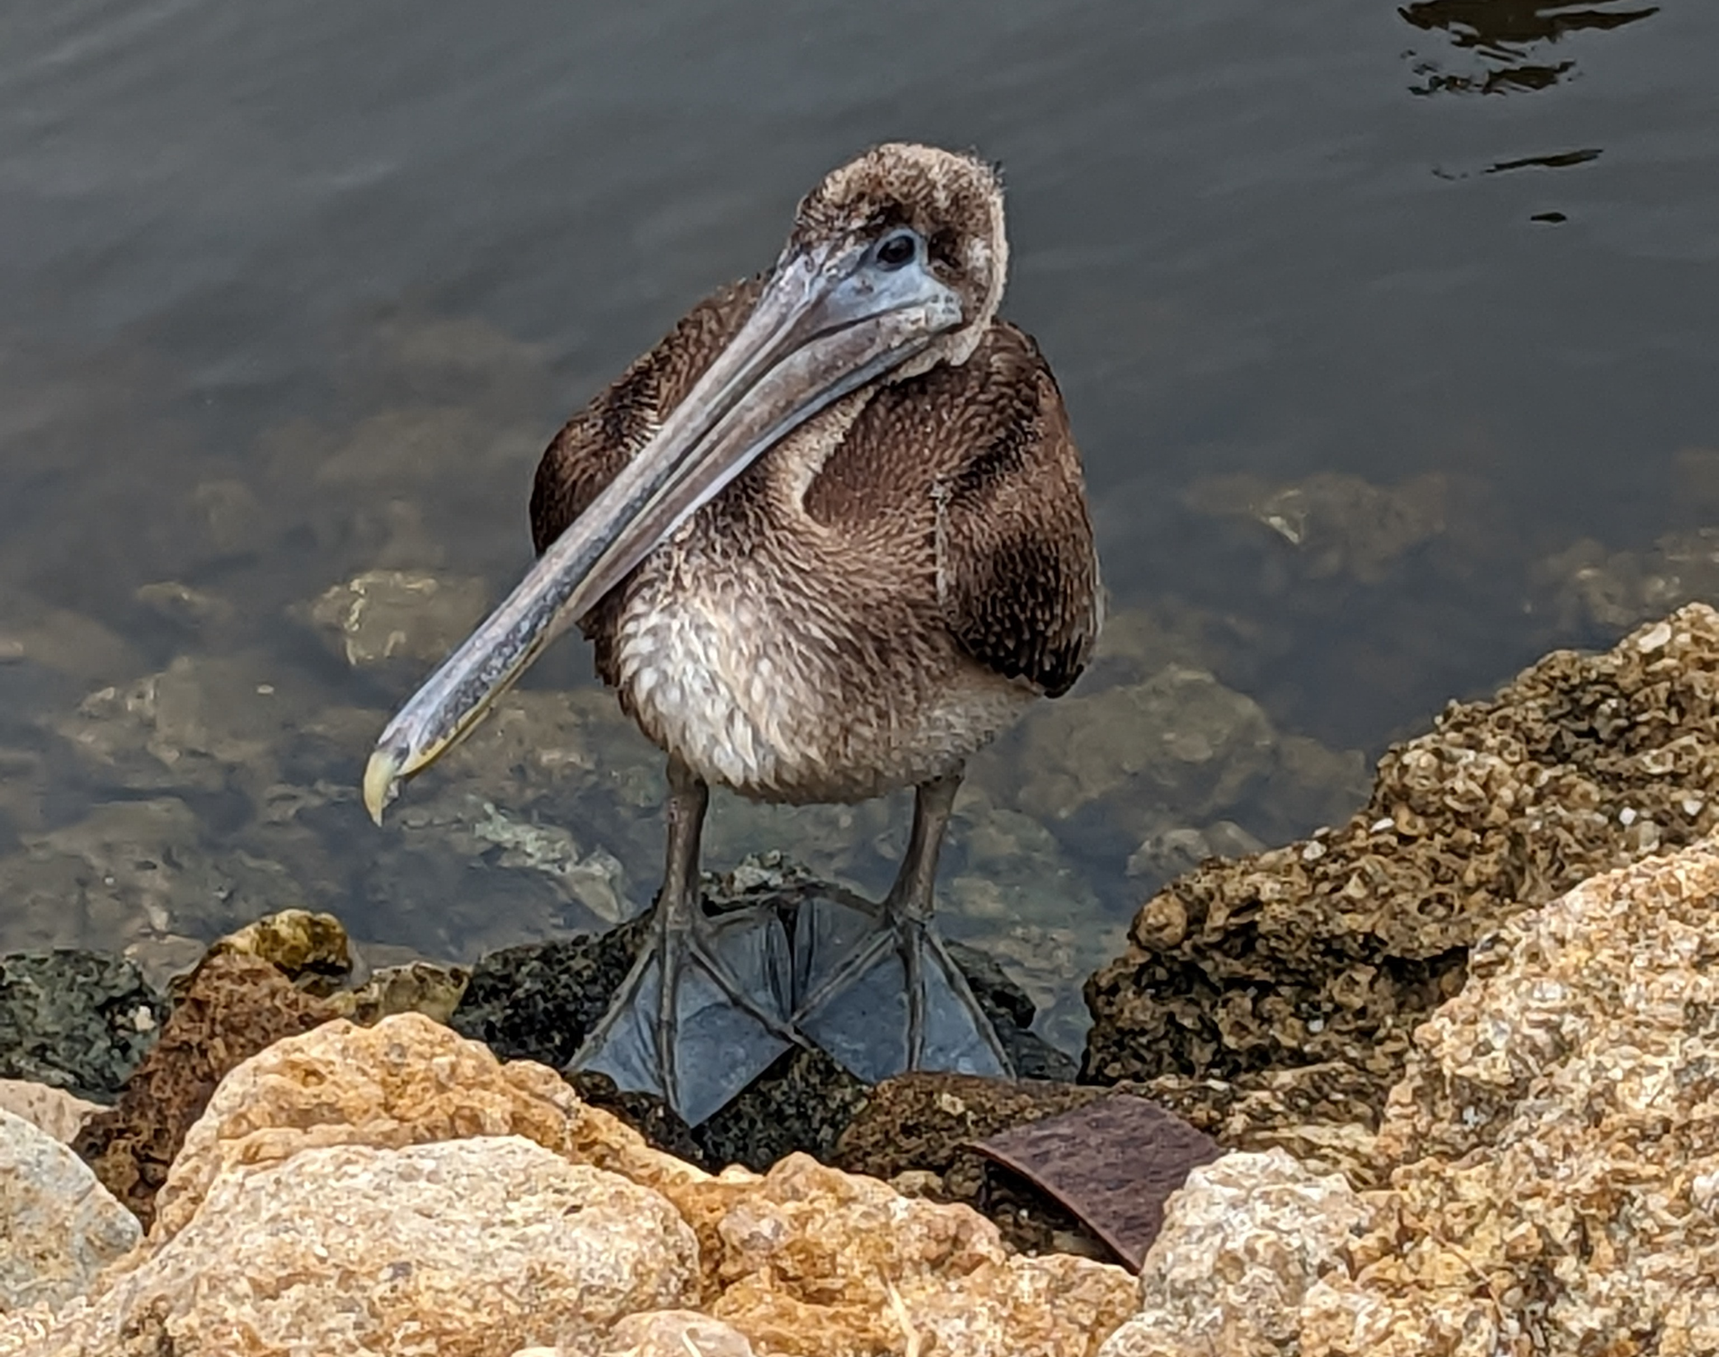
SBA Economic Injury Disaster Loan (EIDL)
Working capital loans to help businesses meet their ordinary and necessary financial obligations that cannot be met as a direct result of the disaster.
These loans are intended to assist through the disaster recovery period.
Small agricultural cooperatives, small businesses engaged in aquaculture, and most private, and non-profit organizations are also eligible.

Slide 32
SBA Economic Injury Disaster Loan
Eligible Uses
Working capital to cover ordinary and necessary operating expenses
Collateral
Required for all EIDL loans over $25,000.
SBA will not decline a loan for lack of collateral, but requires you to pledge what is available.

Slide 33
SBA Economic Injury Disaster Loan
Amount | Up to $2,000,000 per eligible business
Terms | Up to 30 years; case by case
Interest | Businesses & Small Agricultural Cooperatives 3.75% Non-Profits Organizations 2.75%
Payments | First year deferred payments and no interest accrual Afterwards, it’s a long-term fixed payment
Other | Collateral is required for physical loans over $25,000. SBA will not decline a loan for lack of collateral, but it requires you to pledge what is available.
How to Apply | sba.gov/disaster
Notes:
Amount. The maximum loan amount per eligible business is $2,000,000.
Terms
This is the SBA’s standard disaster recovery loan. As you can see, it’s a long-term low with a really competitive interest rate.
Once you get this long-term long, you pay off the short-term emergency bridge loan and use the remaining funds for long-term recovery.
Payments
The SBA defers payments for the first year.
The SBA also does not accrue interest on disaster loans for the first year.
Other
Although collateral is required for loans over $25,000 the SBA will not decline a loan for lack of collateral. It’s the government giving you a good faith gesture by helping you. If you don’t have enough collateral, they require you to return the same good faith gesture by pledging what you do have.
How to Apply
You can either apply at a Disaster Recovery Center, Business Recovery Center, or go online.

Slide 34
When Disaster Strikes…
SBDCs are a part of ESF-18 Business, Industry and Economic Stabilization
We work with the SBA to scout out BRCs
We are stationed at BRCs
We have been stationed at DRCs
Our primary goal is to help with business support
Notes:
Emergency Support Function 18

Slide 35
Summary
2 SBA loans (Physical Disaster & EIDL)
1 State of Florida loan (Emergency Bridge Loan)
SBDC is here year-round
We host webinars and workshops before and after a disaster
We are physically present during a disaster

Slide 36
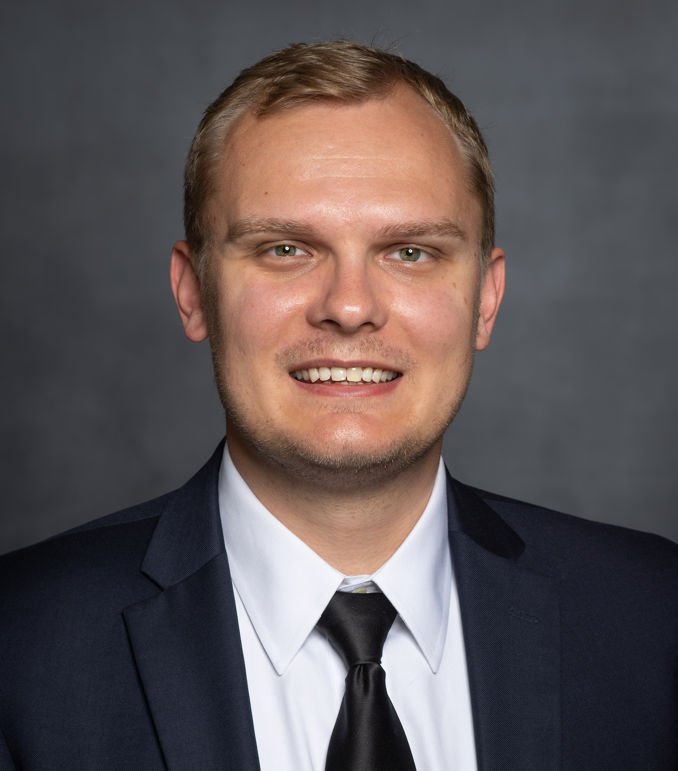
Questions?
Dorian Zwierewicz
Regional Director
Florida SBDC at FGCU
dzwierewicz@fgcu.edu
www.fsbdcswfl.org
FloridaSBDC.org
State Designated as Florida's Principal Provider of Business Assistance [§ 288.001, Fla. Stat.]
The Florida SBDC Network is a statewide partnership program nationally accredited by the Association of America’s SBDCs and funded in part by the U.S. Small Business Administration, Department of Defense, State of Florida, and other private and public partners, with the University of West Florida serving as the network’s headquarters. Florida SBDC services are extended to the public on a nondiscriminatory basis. Language assistance services are available for individuals with limited English proficiency.

Slide 37
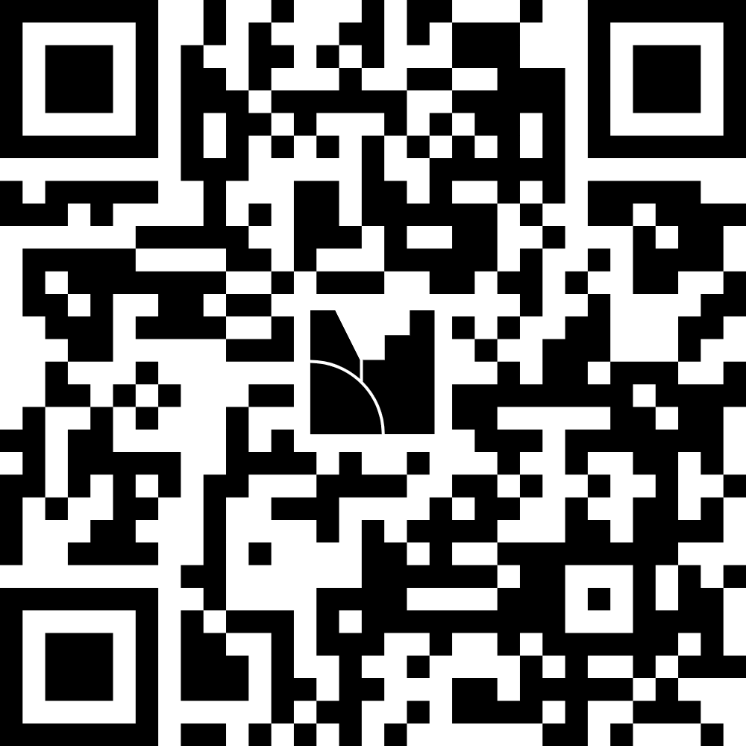
Florida Commerce

Slide 38

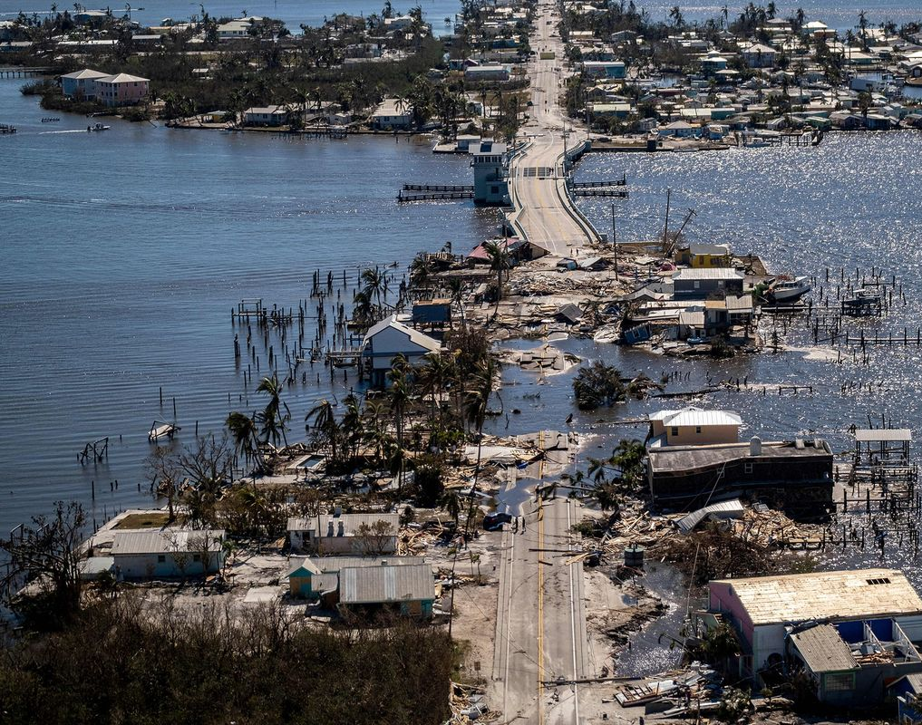
ESF 18: Business, Industry and Economic Stabilization
Charlotte County Hurricane Preparedness
Kimberley Perry, Emergency Coordination Officer – Disaster Response and Recovery Manager
Steven Wood, Alternate Emergency Coordination Officer – Deployment Manager
June 26, 2025

Slide 39

What is ESF 18?
State Agencies:
FloridaCommerce
Department of Business and Professional Regulation (DBPR)
Department of Financial Services (DFS)
Department of Revenue (DOR)
Industry Organizations and Associations
Florida Restaurant and Lodging Association (FRLA)
Florida Retail Federation (FRF)
VISIT FLORIDA
Florida Small Business Development Centers (SBDC)
…and many more!

Slide 40
State Emergency Response Team (SERT)
ESF 1 – Transportation
ESF 2 – Communications
ESF 3 – Public Works
ESF 4 – Firefighting
ESF 5 – Plans
ESF 6 – Mass Care
ESF 7 – Resource Management
ESF 8 – Health & Medical
ESF 9 – Search & Rescue
ESF 10 – Environmental Protection
ESF 11 – Food & Water
ESF 12 – Energy
ESF 13 – Military Support
ESF 14 – External Affairs
ESF 15 – Volunteers & Donations
ESF 16 – Law Enforcement
ESF 17 – Animals & Agriculture
ESF 18 – Business & Industry
ESF 19 – Fuels
ESF 20 – Cybersecurity

Slide 41
ESF 18 Objectives – Coordinate, collaborate and communicate with our community stakeholders for a resilient Florida.
Educate and train the business community, city and county economic organizations, and small business organizations about disaster preparedness and recovery.
Assist in developing and distributing information about business continuity planning to small and medium businesses.
Connect businesses in Florida to emergency management updates through our information sharing network.
www.FloridaDisaster.biz

Slide 42
Responding Events:
Natural Hazards
Technological
Human-Caused
Hurricanes
Tornados
Floods/Drought
Wildfires
Thunderstorms
Winter Storm
Dam/Levee Failure
HazMat Release
Industrial Accident
Pipeline Explosion
Train Derailment
Utility Disruption
Active Shooter
Cyberattack
Terrorism
Special Events
Political Conventions
FIFA Bowl
Space Launches

Slide 43
ESF 18 Disaster Response
ESF 18
Private Sector
Federal Network
State Network
Local Network
Timely updates to the private sector:
Meteorology Reports
Road, Bridge and Airport Closures
Evacuations and Curfews
Recovery Programs and Resources
Messaging sent via:
Email Distribution List
Private Sector Coordination Calls
Private Sector Hotline: 850-815-4925
www.FloridaDisaster.biz

Slide 44
ESF 18 Disaster Recovery
Local ESF 18 teams are subject matter experts that provide critical information to the state about their area of expertise.
Local teams participate in emergency management training, events, webinars and share new resources to promote economic resilience.
ESF 18 City & County Partner Agencies and Organizations:
Emergency Management Offices
Economic Development Offices
Destination Marketing Organizations
Chambers of Commerce
Major Employers
Critical Infrastructure Operators
Regional Manufacturing Associations
Small Business Development Centers
Community Redevelopment Boards
Workforce Development Boards
UF/IFAS Extension Offices
Main Street Programs

Slide 45
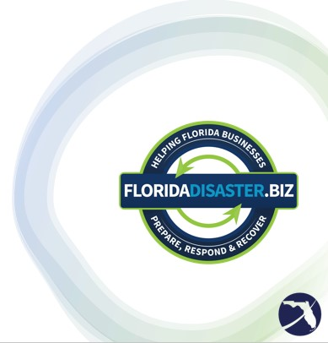
ESF 18 Website
FloridaDisaster.biz is Florida’s virtual business emergency operations center.
The website was designed to provide the latest disaster information to Florida’s business community.
Resources available on FloridaDisaster.biz include:
Business Damage Assessment Surveys
Disaster Planning Toolkit
Current Disaster Updates
State Re-Entry Procedures
Evacuations, Curfews and Road Closures
Recovery Resources and Information
County Contact Information for Businesses

Slide 46
FloridaCommerce Resources
Florida Business Damage Assessment
Survey to document losses. www.FloridaJobs.org/BDA (when activated)
Florida Small Business Emergency Bridge Loan
Short-term, zero-interest working capital loans. www.FloridaJobs.org/EBL
Disaster Unemployment Assistance
Assistance to workers who become unemployed due to a major disaster
www.FloridaJobs.org/DUA (when activated)
Dislocated Worker Grant
Temporary disaster relief jobs for dislocated workers
www.floridajobs.org/disaster-recovery-dislocated-worker-grants (when activated)

Slide 47
Local and County Ownership
All disaster response and recovery efforts start and end at the LOCAL level.
Initial reach should be to your City, County EM personnel
Next level efforts to provide support and resources when agencies are overwhelmed
State officials
Federal officials

Slide 48

Questions & Answers?

Slide 49

Contact Us
Thank You!
If you have questions or comments about this presentation, please contact us.
Steven Wood
Email: steven.wood@Commerce.fl.gov
Office: Communications and External Affairs
Kimberley Perry
Email: kimberley.perry@Commerce.fl.gov
Office: Communications and External Affairs

Slide 50





Business Community Hurricane Preparedness Presentation

Slide 51

CareerSource SW FL – Let Us Help You!
State and Federal Resources
Consultation and Community Resources
Assistance with Employee Services Re-employment
Customized Solutions
Humanitarian Aid
Job Fairs / Hiring Events
Recruitment & Job Matching

Slide 52
CareerSource SW FL Work Based Training Grants
OJT (On the Job Training) Program
Work Experience Program
Customized Training Program
Veteran Services / Disability Navigator
State & Local Resources
Assistance with Registered Apprentice Programs

Slide 53

Tips/Strategies for after a natural disaster
Starts with Before, During & After Event
Contact your Local CareerSource **
3745 Tamiami Trail Pt Charlotte 941-235-5900
Extend recruit network for employer/employees
Employee/Applicant Referrals
Social media / LinkedIn / Facebook
Connect with schools for recruits
Referrals – who do you know!

Slide 54
QUESTIONS?

Slide 55

Thank You!
Bill Welch
Business Services Director
CareerSource Southwest Florida
wwelch@careersourcesouthwestflorida.com
239-931-8200 x 1805
www.careersourcesouthwestflorida.com

Slide 56


UNITED WAY CHARLOTTE COUNTY
BEFORE: We believe that resilience depends on readiness.
Preparing for disasters is a year-round effort that requires attention during both “blue skies” and “gray skies.” (COAD & Alert Charlotte)
Emergency plans should be reviewed before and after every disaster to ensure they are current and effective.
Active partnerships with community and partner agencies are essential to a coordinated and successful response when disaster strikes.
DURING: Activate Disaster Plan 24/48/72 hours.
Acquire and prepare recovery resources for post-storm dissemination (gift, gas cards) Communicate staffing plan and roles.
Share EOC messaging across all social media channels as connectivity allows.
AFTER: Mobilize, Inform, Support.
UWCC shares critical disaster recovery information and connects residents to essential services (i.e. shelter, food, and emergency supplies).
Collaborates with local organizations to mobilize volunteers.
Activate UWCC Disaster Fund for targeted case management, financial assistance, and continued resource navigation.
W W W . U N I T E D W A Y C C F L . O R G

Slide 57
UNITED WAY CHARLOTTE COUNTY
D I S A S T E R R E S P O N S E A C T I O N S
UWCC COMMUNICATION
SUPPLIES & DONATIONS
RECOVERY EFFORTS
COMMUNITY PARTNERS
ADDITIONAL RESOURCES
UWCC actively shares any community information related to disaster.
Supply/Donation sites will be shared by UWCC as they are announced.
United at Work will be activated for disaster recovery, providing support to those working in Charlotte County to help them recover and return to work faster.
UWCC funded partner agencies will report assessed needs after a disaster.
Charlotte County Emergency Management
Volunteer Florida
Limited large item donations (water, tarps, diapers, etc.) will be accepted at UWCC central location.
UWCC will activate funds to assist as appropriate.
Social Media Resources:
List of neighboring United Ways:
Navigators will be available to speak with and assist with recovery efforts.
UWCC Disaster Resources
Gift cards preferred and accepted are:
Publix, Walmart, Gas stations, Home Depot
COAD
United Way Lee County
UWCC Facebook
Volunteer Reception Center (VRC)
United Way South Sarasota
UWCC Disaster Fund
United Way Suncoast
W W W . U N I T E D W A Y C C F L . O R G

Slide 58



UNITED WAY CHARLOTTE COUNTY
Communication & Navigation
United at Work
Families
Seniors
Volunteer Income Tax Assistance program (VITA)
Workforce Resources
Literacy Initiatives (Charlotte County Reads)
Volunteer Mobilization
Mental Health Awareness Initiatives
Digital Navigation
Parent Advisory Council
Referrals & Resource Navigation
Socialization Opportunities
Get Help - Financial Assistance
Engaging Opportunities for Women
Community Partnerships
Disaster Recovery

Slide 59
UNITED WAY CHARLOTTE COUNTY
www.unitedwayccfl.org

Slide 60
Thank you for attending!
Welcome to the 🌪️ 2025 Hurricane Preparedness Webinar for Businesses

