Slide 1
Generations in Today’s Workplace
Why does it even matter?
*Knowing that each generation may believe it is right, and the others are wrong, simply because they have not taken the time to understand or learn about the other generations.
*Attracting, motivating, and retaining employees will be difficult without understanding what inspires each generation.
*The importance of incorporating customer service (internal and external) as a guiding force behind business decisions.
*Transfer of knowledge from those exiting the workplace to the newer workforce.
*Leadership training for those leading/managing the younger employees AND for the future leaders.
*Important for succession planning and identifying the emerging leaders of future leaders.
*Playing on the strengths of each generation to produce a stronger, more productive workforce.
*Learning to flex for “work-life balance” and other benefits will be necessary to stay competitive.

Slide 2
Generations in Today’s Workplace
Traditionalists 1925-1942 age range
Greatest Generation 1925-1945 100-80
Silent Generation 1928-1945
Baby Boomers 1943-1960 age range
Boomers 1946-1964 82-61
1946-1964
Generation X 1961-1981 age range
Gen X 1965-1980 61-45
Xers 1965-1980
Generation Y 1982-1994 age range
Millennials 1981-2000 44-25
Gen Y 1981-1996
Generation Z 1995-2010 age range
Gen Z 2001-2020 30-5
Anxious Generation 1997-2012

Slide 3
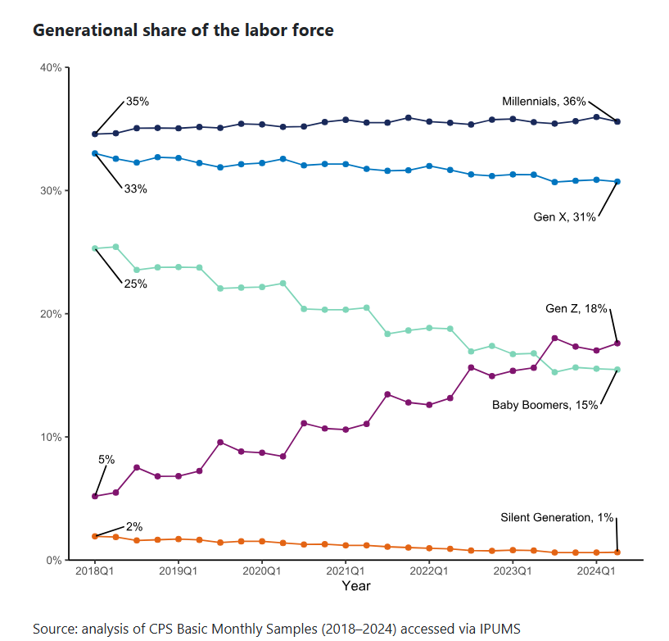
Generations in Today’s Workplace
Millennials: 36%
Generation X: 31%
Generation Z: 18%
Baby Boomers: 15%
Silent Generation (Traditionalists): 1-2%

Slide 4
How old were you when you got your first job?
Where did you work?
How old were you when you got your first cell phone?
What is the longest you have stayed at one job?
How many TV channels did you have growing up?
How did you get typically to/from school daily? (age 5-14)
How did you learn about news; what medium? (age 16)
What did you do during your summer break from school? (age 13)
Give me an example of a national/global event in your lifetime that has impacted you and how you live your life.

Slide 5
Traditionalists 1925-1942
Greatest Generation 1925-1945
Silent Generation 1928-1945
Common Characteristics:
Dependable, Straight Forward, Tactful, Loyal, Strong work ethic
Things that shaped their generation:
The Great Depression, World War II, radio, movies
What motivates them?
Respect, recognition, clear expectations & processes, development opportunities
What communication style do they prefer?
Personal touch, handwritten notes, phone calls, meetings
Worldview:
Obedience over individualism, age equals seniority, advancing through the hierarchy

Slide 6
Baby Boomers 1943-1960
Boomers 1946-1964
1946-1964
Common Characteristics:
Optimistic, competitive, workaholic, team-oriented
Things that shaped their generation:
The Vietnam War, civil rights movement, Watergate, Rock & Roll, death of JFK
What motivates them?
Company loyalty, teamwork, duty, money
What communication style do they prefer?
Whatever is most efficient, face-to-face, phone calls, meetings
Worldview:
Achievement comes after paying one’s dues, sacrifice for success

Slide 7
Generation X 1961-1981
Gen X 1965-1980
Xers 1965-1980
Common Characteristics:
Flexible, informal, skeptical, independent
Things that shaped their generation:
AIDs epidemic, fall of the Berlin Wall, the dot-com boom, 1st latch key kids
What motivates them?
Diversity, work/life balance, money, fringe benefits, autonomy
What communication style do they prefer?
Whatever is most efficient, face-to-face, phone calls, emails
Worldview:
Diversity, quick to change jobs if needs aren’t being met, sensitive to changes that will affect their personal lives

Slide 8
Generation Y 1982-1994
Millennials 1981-2000
Gen Y 1981-1996
Common Characteristics:
Competitive, civic and open minded, achievement oriented
Things that shaped their generation:
Columbine, 9/11, the internet, social media
What motivates them?
Responsibility, quality of their leadership, unique work experiences
What communication style do they prefer?
IMs, texts, and emails
Worldview:
Seeking challenge, growth, & development, fun work life, work/life balance, will leave a stagnant environment

Slide 9
Generation Z 1995-2010
Gen Z 2001-2020
Anxious Generation 1997-2012
Common Characteristics:
Global, entrepreneurial, progressive, less focused
Things that shaped their generation:
Life after 9/11, Great Recession, access to technology from a very young age
What motivates them?
Diversity, personalization, individuality, creativity
What communication style do they prefer?
IMs, texts, and emails
Worldview:
Digital device addicts, value independence & individuality; prefer Millennial managers, innovative coworkers, & new technology

Slide 10
Issues, Concerns, Complaints, & Frustrations?
Traditionalists 1925-1942 age range
Greatest Generation 1925-1945 100-80
Silent Generation 1928-1945
Lack of flexibility, resistant to new technology, work is a necessity, communication style, difficulty adapting to change, entitled
Baby Boomers 1943-1960 age range
Boomers 1946-1964 82-61
1946-1964
Outdated communication styles, paper usage, resistant to new technology, preference for formal meetings, hierarchal structure, perceived focus on power, entitled
Generation X 1961-1981 age range
Gen X 1965-1980 61-45
Xers 1965-1980
Perceived to be unloyal, less adaptable to technology, perceived to have a lack of initiative, prefer direct communication, cynical, entitled
Generation Y 1982-1994 age range
Millennials 1981-2000 44-25
Gen Y 1981-1996
Perceived lack of work ethic, issues with social media etiquette, understanding traditional hierarchical structures, and balancing work-life balance; entitled
Generation Z 1995-2010 age range
Gen Z 2001-2020 30-5
Anxious Generation 1997-2012
Perceptions of low engagement, difficulty navigating traditional workplace norms, a preference for flexibility and purpose over traditional work ethic, entitled

Slide 11
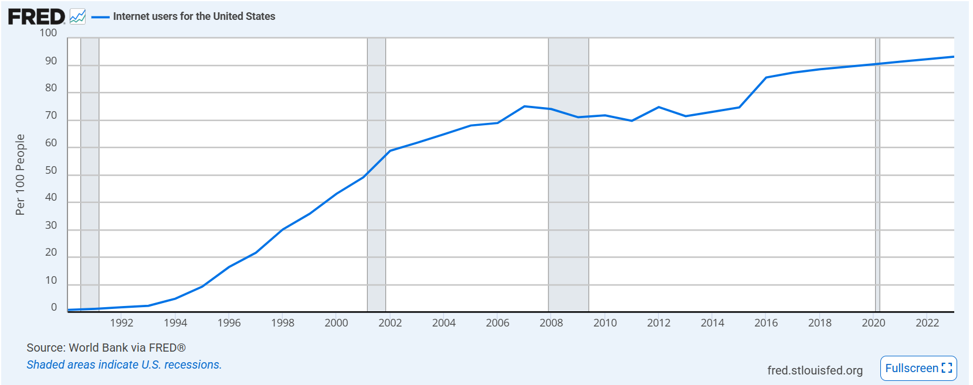
Internet Usage Through the Years

Slide 12
Things that make you go hmmm…………
The Traditionalists grew up during the Great Depression and World War II, which instilled in them a sense of prudence, determination, and respect for authority. Their age of “adulthood” was 18.
49% of Baby Boomers want to continue working into their 70s & some plan to never retire.
Gen X are less likely to discuss their mental health, due to the culture in which they were raised.
When looking for a job, Millennials will take a pay cut for a better work environment.
The age of “adulthood” with Gen Z and Millennials is 27.

Slide 13
Generation Z
They admire people whose work/life balance is their top priority rather than their passion for work, job title, or seniority.
They prefer flexibility, they see no need in working late if their work is completed.
They need open conversations about boundaries, expectations, and WHY.
Gen Z struggle with mental health more than other generational groups. No other generation has had such immediate and unfiltered access to the news for most of their lives, which can lead to stress, anxiety, and other mental health issues. Thus the “Anxious” Generation.
Gen Z want to move up in the workplace quickly, expecting promotions within 18 months of hire. Employers can lay out clear paths for promotions. Each generation have different opinions about how promotions should be earned.
They have a low tolerance for companies that don’t follow through on missions and promises, and they are not afraid to leave if things aren’t what they seem.
Diversity is normal to them.
They can potentially live to see the year 2100.

Slide 14
How do we work and interact with each generation?
Traditionalists 1925-1942 age range
Greatest Generation 1925-1945 100-80
Silent Generation 1928-1945
Patience, understanding, recognition, clear expectations, development opportunities
Baby Boomers 1943-1960 age range
Boomers 1946-1964 82-61
1946-1964
Understand their need for work/life balance, they need clear objectives, patience with technology, they need to see value in their work, they appreciate recognition
Generation X 1961-1981 age range
Gen X 1965-1980 61-45
Xers 1965-1980
Open and clear communication; esp regarding company news, values, and direction, autonomy, feedback, good workplace culture, consistent increase in salary/benefits
Generation Y 1982-1994 age range
Millennials 1981-2000 44-25
Gen Y 1981-1996
Opportunities to grow, work/life balance, flexibility, clear expectations and guidance, enjoyable work culture, team activities
Generation Z 1995-2010 age range
Gen Z 2001-2020 30-5
Anxious Generation 1997-2012
Psychological safe workplace, opportunities for team building & mentorship, digital communication, allow them to share thoughts, ideas, and feelings w/o judgement

Slide 15
Sticking Points
Teams can get stuck on these points, which can lead to conflict, frustration, and stereotyping in the workplace.
Communication
Decision Making
Dress Code
Feedback
Fun at Work
Knowledge Transfer
Loyalty
Meetings
Policies
Respect
Training
Work Ethic

Slide 16
Let’s learn something about each other………
How old were you when you got your first job?
Where did you work?
How old were you when you got your first cell phone?
What is the longest you have stayed at one job?
How many TV channels did you have growing up?
How did you typically get to/from school? (age 5-14)
How did you learn about news; what medium? (age 16)
What did you do during your summer break from school? (age 13)
Give me an example of a national/global event in your lifetime that has impacted you and how you live your life.
Having a diverse workforce improves productivity in the workplace!

